Slide 1

SUPER STORE

Slide 2
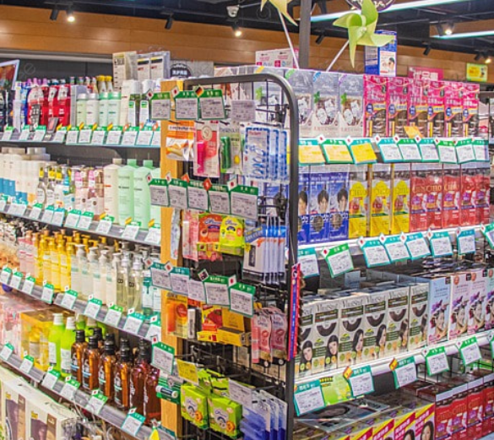
INTRODUCTION
The report extensively analyzes sales and profit data across various product categories.
The data highlights variations in financial performance among categories, including profitable and challenging segments.
The analysis delves into profit-influencing factors, emphasizing significant contributors and areas needing improvement.
The data informs strategic decisions for improved profitability and strategy.

Slide 3

Total Sales and Profit
Superstore’s revenue over the four-year period from 2014 to 2017 reached $2,270,658, while it generated a profit of $282,393.

Slide 4
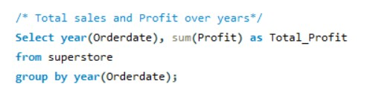
Profit Over Years
Profit steadily increased each year from 2014 to 2017: $48,921, $60,892, $79,989, and $92,591
Superstore’s total profit experienced substantial growth, rising by $43,670 over this four-year period, reflecting a consistent upward trend.

Slide 5
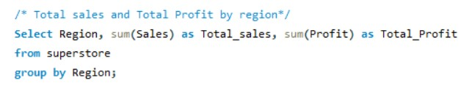
Sales and Profit by Region
The South region generated $388,309 in sales with a corresponding profit of $45,878.
The West region achieved $713,525 in sales and a profit of $105,983.
The Central region reported $496,701 in sales and $39,885 in profit.
The East region had sales of $672,123 and a profit of $90,647.

Slide 6
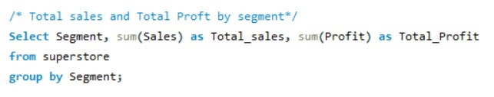
Sales & Profit by Segment
The Consumer segment achieved $1,149,958 in sales with a corresponding profit of $132,556.
The Corporate segment reported sales of $696,229 and a profit of $90,277.
The Home Office segment generated $424,471 in sales and $59,560 in profit.
The Consumer segment led in both sales and profit, followed by the Corporate segment, while the Home Office segment contributed with slightly lower sales and profit figures.

Slide 7
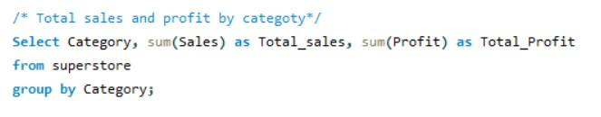
Sales & Profit by Segment
The Furniture category achieved $733,051 in sales with a corresponding profit of $16,975.
Office Supplies reported sales of $703,571 and a profit of $120,473.
The Technology category generated $834,036 in sales and $144,945 in profit.
The Technology category led in both sales and profit, followed by the Office Supplies category, while the Furniture category contributed with slightly lower sales and profit figures.

Slide 8
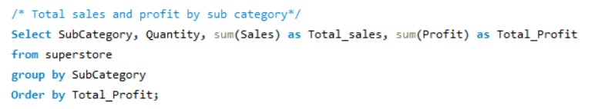
Sales and Profit by Sub-Category
The Copiers category recorded the highest sales, reaching $149,530, and the highest profit, totaling $55,618.
The Tables and Bookcases categories reported negative profits, indicating losses of -$17,733 and -$3,479, respectively.
While Copiers and Phones categories led in terms of profit, the Tables and Bookcases categories showed losses. Other categories demonstrated varying levels of sales and profit performance.

Slide 9
Sales & Profit by Quantity
Some subcategories, such as Copiers and Phones, demonstrate strong profitability, with earnings of $55,618 and $44,422, respectively.
Conversely, Tables and Bookcases subcategories face challenges, reporting negative profits of -$17,733 and -$3,479, indicating areas that require improvement.
The profit performance of subcategories is not solely dependent on quantity sold. Some subcategories, despite lower quantities, manage to generate positive profits, while others with higher quantities face profit challenges.

Slide 10

Conclusion
Total sales have shown consistent growth over time, indicating a positive market response.
Focus on high-performing categories and subcategories to sustain and improve profitability.
Categories like Machines and Labels offer opportunities for optimizing profit margins.
Sales quantity alone does not guarantee higher profits; profit margins and pricing strategies matter.
Tables and Bookcases consistently report negative profits, requiring cost and pricing strategy attention.

